Slide 1

Is More Always Better? The Challenge of Unit Creep and Rising Contact Hours
Craig Rutan, Santiago Canyon College
John Stanskas, San Bernardino Valley College
James Todd, Modesto Junior College

Slide 2
Overview
What is Unit Creep? What is Inflated Contact?
How do we best allocate student load, or time in courses, across our institution?
“Perfect” Unit Value
Unit Creep and Inflated Contact: The Impact on Students
Evaluation of Courses

Slide 3
Before We Begin
Faculty create courses to meet the needs of students.
Our goal today is to discuss strategies for faculty and curriculum committees to ensure that the courses and programs we create are serving their purpose for students and meeting institutional goals without unintentional consequences.

Slide 4

What is Unit Creep & Inflated Contact?
Unit creep occurs when a course has more units than are “necessary”
Unit creep can be related to inflated contact time and “student load” (student time in a particular class or sequence of classes)
The number of “necessary” units could be determined based upon
Similar courses at other CCCs
Similar courses at a CSU/UC
C-ID Descriptor
GE Area Units

Slide 5
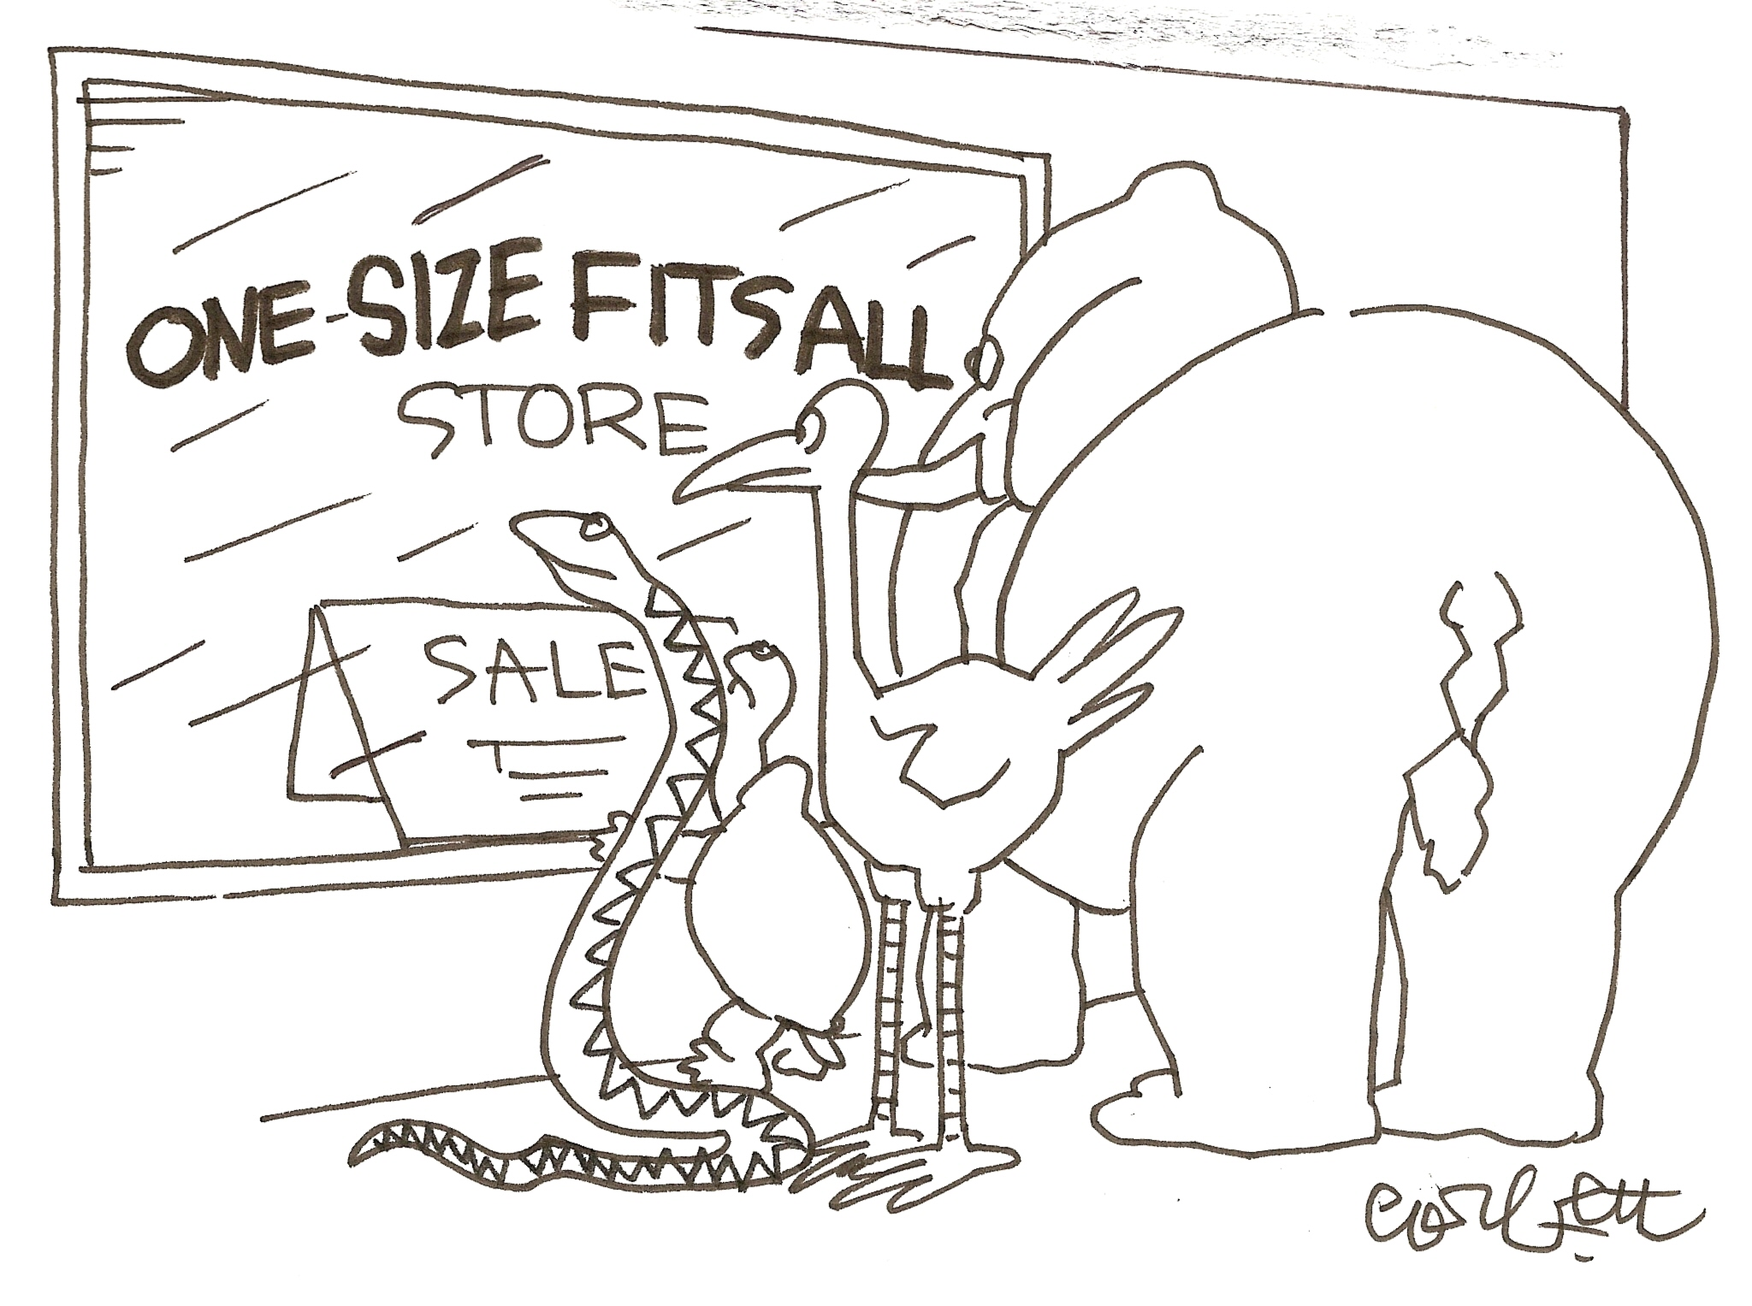
Is There One Perfect Unit Value?
There is no one size fits all model to units or the contact time associated with it
In many cases, the commonly accepted number of units for a course might make sense for your students
Think strategically across your curriculum: how do unit values and contact time affect student success?

Slide 6
Is There One Perfect Unit Value?
If the units or contact time for the course at your college is different than the norm, you should be able to justify why that is so.

Slide 7
Discussions for Colleges
Are we attempting to cover and assess more content than the norm? If so, why?
Are we doing more review/catch up and “homework” examples in class?
Does increasing the number of classroom contact hours increase student success?
Are there “bottlenecks” or access issues at your institution? If so, how do you best improve access and success while maintaining quality and rigor?

Slide 8
Impact on Students
When the number of units and resulting contact time for a course are increased, there are possible impacts that must be considered.
Students can enroll in fewer classes which could increase the time to reaching their educational goal.
Students will be paying more to take the “same” course that costs less at the college down the street.
Students may exhaust their financial aid more quickly than expected.
Students may not be prepared for rigor of transfer institutions.

Slide 9

Transfer Degrees
Associate Degrees for Transfer (ADTs) can be no more than 60 units. This unit total includes the courses in the major and the completion of CSU GE Breadth/IGETC (or STEM options of either).
SB440 requires colleges to create an ADT if a TMC exists and the college has an approved AA/AS degree

Slide 10
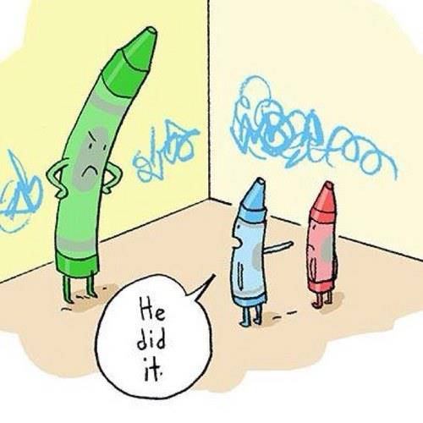
Who is to Blame?
All TMCs make assumptions about units – of individual courses and CCC transfer GE patterns.
Faculty need to consider what is best for the students and the college.

Slide 11

What about the time we need with students?
While it might seem as though higher contact time equals higher success, more contact can affect:
Student load
Student time management
Institutional bottlenecks
Curriculum offerings and scheduling
General education breadth
Financial aid

Slide 12
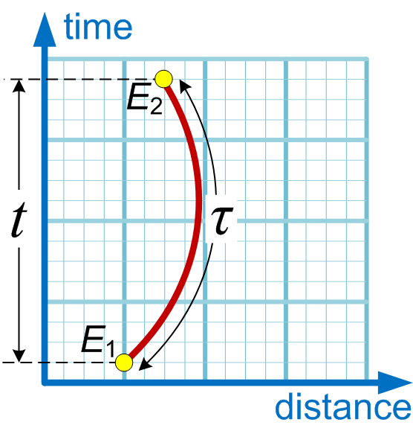
Determining the “Proper” Unit Value and Contact Time
What topics must be covered?
How much time it takes to cover each topic?
Reviewing C-ID descriptors, outlines from other CCCs, and courses at local universities.
Know where your students are transferring!
Look at nearby colleges because your students will be.

Slide 13
Evaluating the Number of Units and Contact
Have AO provide details about similar courses and C-ID descriptors
What criteria should be considered when having more units than C-ID?
Curriculum committees should examine curriculum through the lens of student success—and how students flow through the institution from entry to exit and beyond

Slide 14
What About Student Success?
In many cases, the number of units and contact time were increased because students need more practice time with the instructor.
Improving student success is always our goal. Some questions you might want to consider when increasing contact hours like this are:
Are these additional hours really lecture?
Do all students need these additional hours?
Would an optional instructional lab or noncredit course produce similar results?
What is the effect on student load across the curriculum (one area versus others)?
Is there an effect on GE breadth?
Are there issues of access to courses, scheduling and offerings?

Slide 15
Evaluation by Curriculum Committees
Does your curriculum committee look at the unit value and contact time when evaluating CORs?
Possible Considerations When Evaluating Units/Contact Hours:
Typical Unit Value (C-ID minimum, Assist agreement with CSU or UC, other):
Proposed Local Unit Value:
Justification: What is the need for and/or benefit of allocating additional units or contact time
Support Data: For example, success rates, state and/or other mandates/requirements, existing articulation agreements.

Slide 16
Something to Ponder
The CSU BoT voted in favor of changing degree unit limits to 120 units to have students graduate within four years.
Could a 60 unit limit be placed on ALL AA/AS degrees like we already have for ADTs?
Is a 60 unit degree meant to have corresponding contact time that goes well beyond 60 contact hours?
Notes:
Based on the growing popularity of the thought that students/the state/the public expect that degree completion requires a finite number of units

Slide 17

Something to Ponder - Statistics
252 courses that satisfy CSU GE B4 and have “stat” in the title
1 is 6 units (Statway Part II at ARC)
23 are 5 units
2 are Honors (non-Honors is less)
2 are Statway
7 are quarter units (so the courses are NOT 5 semester units)
Notes:
Based on the growing popularity of the thought that students/the state/the public expect that degree completion requires a finite number of units

Slide 18
Something to Ponder - Statistics
24 5-6 unit stats courses
12 may be “justified”
Only 12 of these extra-high unit stats courses exist without some obvious means of “justifying”
139 are 4 units
89 are 3 units (minimum units in C-ID)
Notes:
Based on the growing popularity of the thought that students/the state/the public expect that degree completion requires a finite number of units

Slide 19

Something to Ponder - Accounting
9 + 1 CCCs with Financial Accounting at 5 units
DAC, EVERGRN, FULLRTON, GLENDALE MTSAC, NAPA, SBCC, SJCC, SMCC
+1 Foothill
1 @ 4.5 – Copper Mountain
44 @ 4 units
13 @ 3 units
What about the CSU’s?

Slide 20
Something to Ponder - Accounting
What about CSU?
5 units – 2 – CPSLO, CSUB
4 units – 4 – CPSLP, CPP, CSUEB, CSULA
3 units – 11 – CSUC, CSUCI, CSUDH, CSUFULL, CSULB, CSUN, CSUSM, CSUSTAN, HSU, SDSU, SJSU

Slide 21

Ticking Clock
The Chemistry ADT was released in February 2015, starting the 18 month AB440 clock.
What will your college do with it’s local degree?
Is it ethical to delete a degree so as not to be forced to comply with SB440?

Slide 22
What to Take Back to Your Campus?
How many courses do you have that require more units than the C-ID descriptors?
Are there TMCs that you cannot develop because of the 60 unit limit?
Are the increased hours or contact time benefiting the students or affecting the institutional capacity for student access?
Would reducing the units or contact on some courses harm students more than it would help?

Slide 23
A note for tough conversations
Discipline faculty should be looked to for their expertise, the authority over curriculum is the Academic Senate/Curriculum Committee.
Title 5 § 55002. Standards and Criteria for Courses: A degree-applicable credit course is a course which has been designated as appropriate to the associate degree in accordance with the requirements of section 55062, and which has been recommended by the college and/or district curriculum committee and approved by the district governing board as a collegiate course meeting the needs of the students.
Local Curriculum Committee needs written process

Slide 24
Summary
Unit creep and inflated contact did not begin with transfer degrees. It has been happening for years and the ADTs have forced us to look at the issue.
There may be good reasons to have more than the “typical” unit value, but faculty need to weigh the value of the increased units and contact time against potential harm done to students.
Existing courses can be changed and faculty should be thinking about whether less would be more.

Slide 25
Thank You For Coming
Do you have any questions?
Craig Rutan: rutan_craig@sccollege.edu
John Stanskas: pstanska@sbccd.cc.ca.us
James Todd: toddj@yosemite.edu

